Slide 1
Automatic App Registration & Authentication

Slide 2
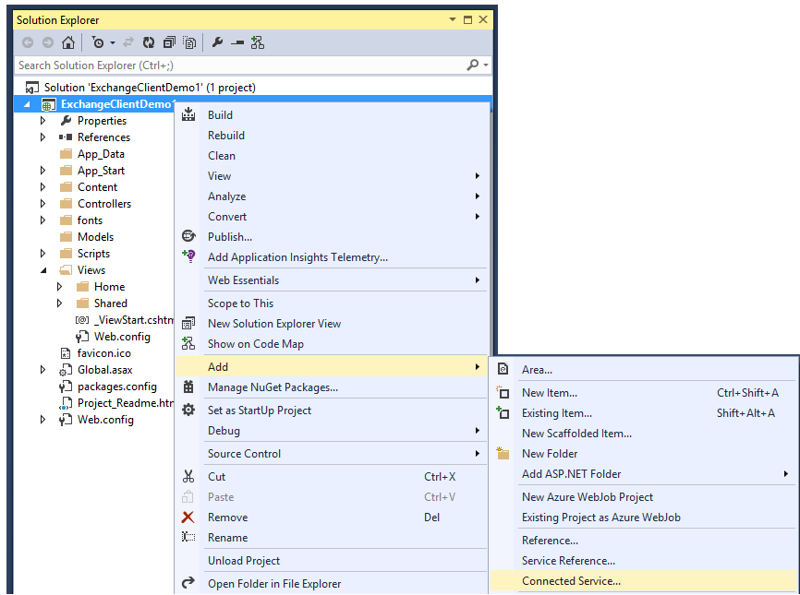
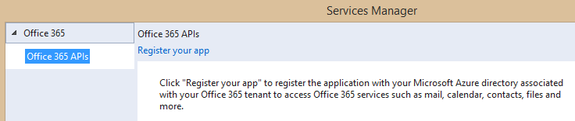
Adding Connected Services
1
Project > Add > Connected Service…
2
Register your app

Slide 3
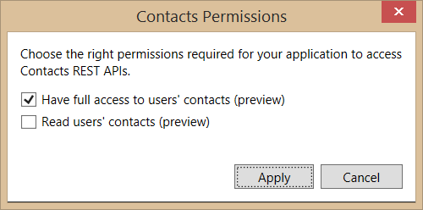
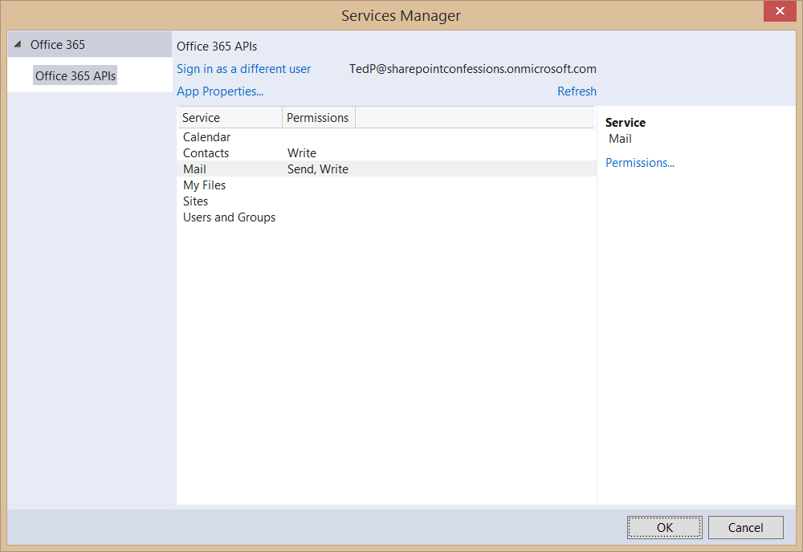
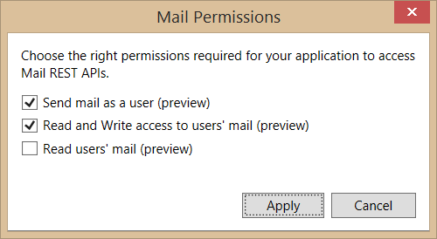
Connected Services Permissions
3
Select required app permissions

Slide 4
DEMO
Connecting MVC to Office 365

